Slide 1

Customer Shopping Behavior Analysis
Deep dive into 3,900 transactions to uncover spending patterns, product preferences, and strategic growth opportunities.

Slide 2
Dataset at a Glance
3.9K
18
50
Total Purchases
Key Features
Locations
Comprehensive transactional records analyzed.
Demographics, purchase details, and behavior metrics.
Wide geographic reach across the dataset.
Key features include age, gender, category, subscription status, and review ratings.

Slide 3

Data Preparation & Engineering
Ensuring data integrity through Python-based cleaning and transformation.
Cleaning & Imputation
Standardization
Feature Engineering
Handled missing ratings using category medians.
Applied snake_case naming and dropped redundant promo columns.
Created age groups and purchase frequency metrics.

Slide 4
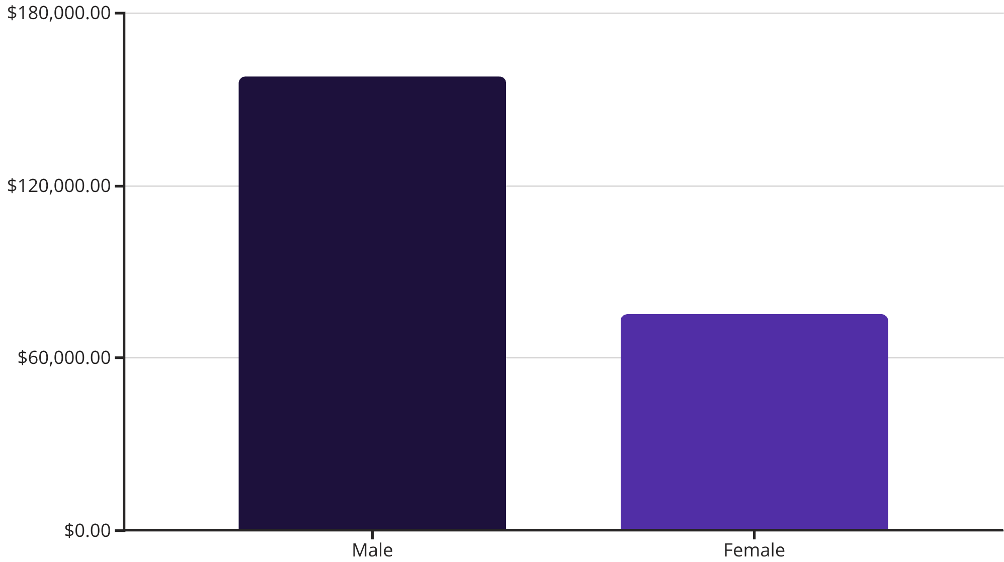

Revenue & Demographics
Gender Spending Gap
Male customers contribute significantly higher total revenue compared to female customers.
Total Revenue: $233,081

Slide 5



Top Rated Products
Customer satisfaction leaders based on average review ratings.
3.86
Gloves
3.84
Sandals
3.82
Boots
3.80
Hats

Slide 6
Subscription & Loyalty Analysis
Customer Segments
Subscription Impact
Loyal: 3,116 customers
Status
Avg Spend
Returning: 701 customers
New: 83 customers
Subscribers
$59.49
Non-Subscribers
$59.87
Interestingly, non-subscribers show a slightly higher average spend per transaction.

Slide 7
Category Leaders
Most purchased items within each major product category.
Accessories
Clothing
Jewelry (171 orders)
Blouse & Pants (171 orders)
Footwear
Outerwear
Sandals (160 orders)
Jacket (163 orders)

Slide 8
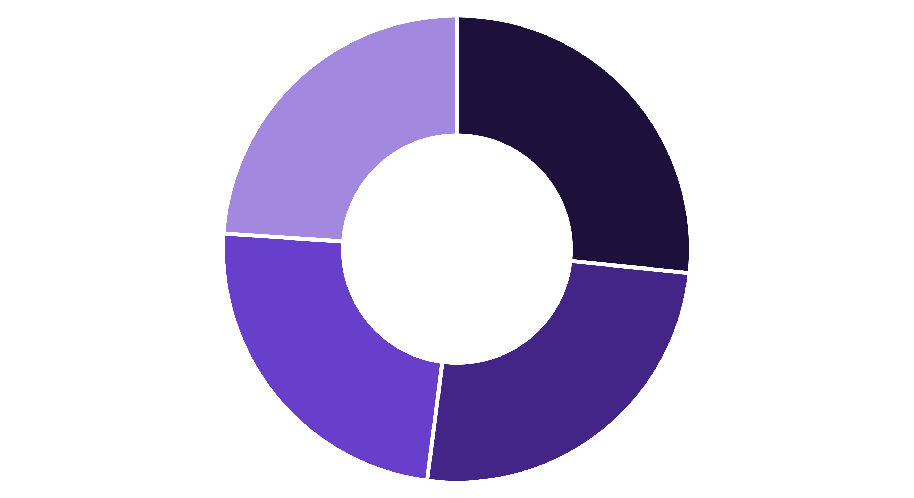
Revenue by Age Group
Spending is remarkably balanced across different life stages.
Young Adult
Middle-aged
Adult
Senior

Slide 9

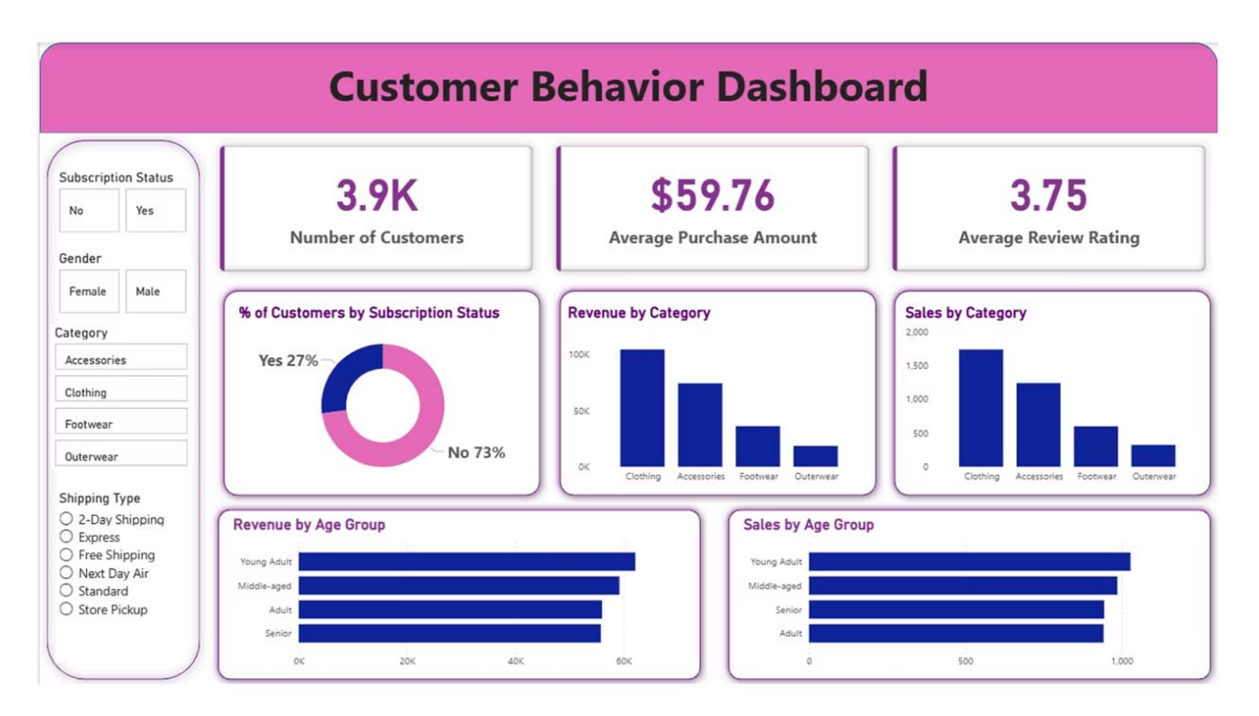
Visual Dashboard Overview
Integrated Power BI view showing sales trends and demographic distributions.
The dashboard provides real-time filtering by season, category, and location.

Slide 10

Strategic Recommendations
Boost Subscriptions
Loyalty Programs
Promote exclusive benefits to convert the 2,847 non-subscribers.
Reward repeat buyers to solidify the "Loyal" segment.
Targeted Marketing
Focus on high-revenue age groups and express-shipping users.

